Slide 1
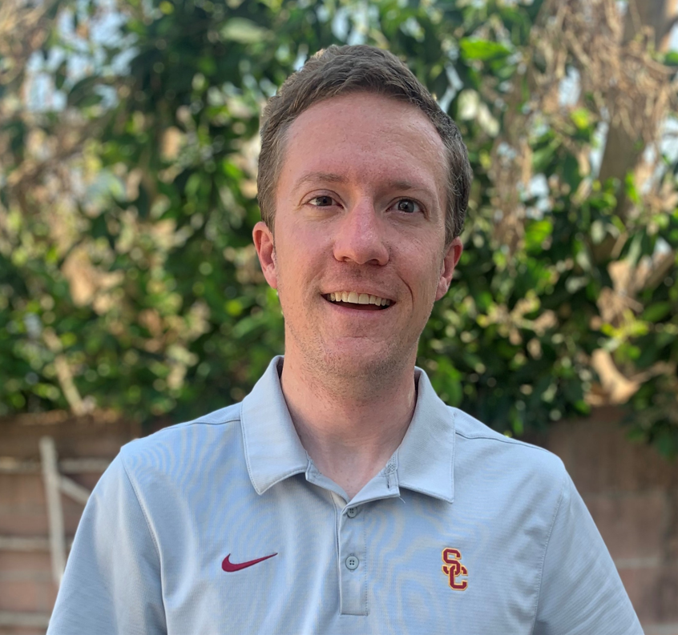
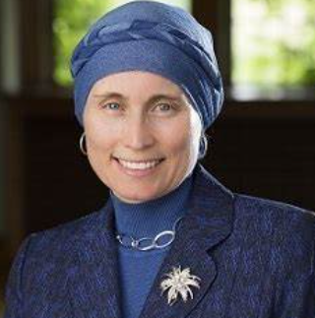
Engaging with the ASEE Corporate Member Council (CMC)
P.J. Boardman
Director, STEM Outreach and Workforce Development, MathWorks
Chair of ASEE-CMC
Jordan Clarke
Senior Manager, Workforce Strategy & Leadership Development
The Boeing Company
Dr. Gregory Triplett
Dean, School of Science and
Engineering
Saint Louis University
Dr. Jacqueline El-Sayed
CEO, ASEE
Notes:
10 mins- Intros

Slide 2
Agenda
What is the mission of CMC?
What are some CMC Initiatives?
How can I get more involved with CMC?
Breakout Groups
Report Out
Notes:
Mention Gregory’s idea-here.

Slide 3
ASEE Corporate Member Council (CMC) Mission
Mission
The CMC's mission is to foster, encourage, and cultivate the dialogue between industry and engineering educators.
Strategic Goals
Create diversity in engineering education
Advise ASEE leadership on Industry needs from education
Enhance the K-12 educational pipeline and the future workforce
Transform engineering education
Collaborate on engineering research and intellectual property
Liaison with engineering, technology, and the Society

Slide 4
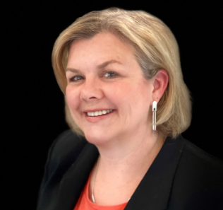
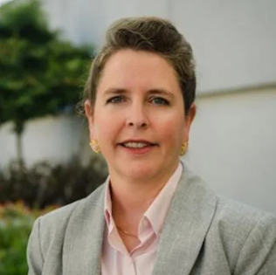
Who are our members?
P.J. Boardman
Director, STEM Outreach and Workforce Development MathWorks
Chair - CMC
Organizations in CMC include:
Siemens
MathWorks
Autodesk
The Boeing Company
GM
Chevron
HP
Ansys
Edge Impulse
Infinity
ABET
DuoLingo
KeySight Technologies
Robonation
Texas Instruments
National Instruments
Dassault Systems
Quanser
…and we are growing
Stephanie Harrington
Director of Constituent Relations at ABET
Chair-Elect-CMC
Dora Smith
Senior Director, Global Academic Programs
Siemens
Past Chair- CMC
Cynthia Murphy-Ortega
Chevron
Treasurer and EDI Liaison- CMC
Notes:
Who you are and why you joined CMC
We want to welcome new members to CMC as well with IAB Members

Slide 5
What are Examples of Academia/Industry Collaborations with the CMC?

Slide 6
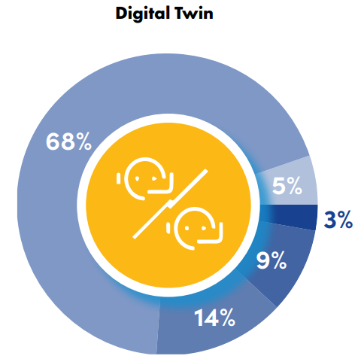
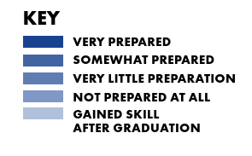
ASEE CMC Initiatives- Skills Gap Survey Technical Skills
Blend academic research in emerging technologies into coursework
Notes:
This preceded Chat GPT and Generative AI so certainly the topic of AI certainly been an important one we are discussing here.

Slide 7
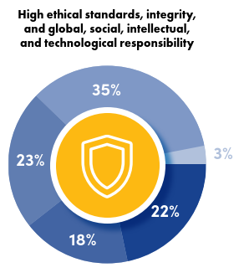
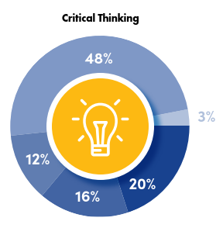
Professional Skills
Incorporate real-world case studies and project-based learning to improve project management and business skills

Slide 8
Industry 4.0 Workforce Summit
Key Findings
Notes:
April ‘22– There will be a session on this topic at the upcoming annual converence; Dan Sayre, A representative for the State of Maine

Slide 9
Challenges for Universities
University as a Service – provide learners multiple on-ramps and off-ramps for programs of study throughout their careers
Multi-sector collaboration – build long-term strategic partnerships with employers, policymakers, and other education providers
Customization at scale – evolve program design and delivery from 1:many to many:1.

Slide 10
University as a Service
Diversify
Provide multiple on-ramps and off-ramps for programs of study throughout a learner’s career
Connect
Collaborate with secondary education providers (e.g., dual enrollment programs to speed access to postsecondary degree programs and employment)
Coordinate
Deepen alignment with non-baccalaureate-granting post-secondary providers (e.g., articulation agreements with community colleges to ensure credit transfer)
Retain
Maintain ongoing relationships with alumni to return for graduate programs, certificates, and specialized training in partnership with their employers

Slide 11
Multi-sector collaboration
Consider these long-term strategic planning partnership models:
Greater Washington Partnership - a “super-regional” collaboration to execute a long-range economic growth strategy for the 7th largest regional economy in the world
Talent Pipeline Management A US Chamber of Commerce Foundation program to help companies plan for sourcing their talent the same way they plan for other essential inputs and resources
Smart Manufacturing Innovation Centers – industry-university partnerships to create centers of excellence that focus on building industry-specific Smart Manufacturing ecosystems.

Slide 12
Customization at scale
Evolve program design from 1:many to many:1
Adopt greater use of microcredentials to enable learners to build stackable and portable records of individual learning achievement
Grant credit to incoming students based on demonstrated competencies rather than prior course completion
Provide more options for internships and co-op work for credit
Partner more closely with employers on course and program design
Allow more flexible timelines for stopping and restarting programs

Slide 13
ASEE CIEC- Conference for Industry and Education Collaboration
Join us next year 2/5-2/7/25
Henderson City, Nevada
Organized by the Cooperative and Experiential Education Division (CEED), the College Industry Partnership Division (CIPD), the Continuing Professional Development Division (CPDD), and the Engineering Technology Division (ETD)
Annual conference has been a place for workshops and panels emphasizing the long and mutually beneficial partnerships among education, industry, and government.
Notes:
Jackie—take this slide

Slide 14
CMC Excellence in Engineering Education Collaboration Award
This award program recognizes CMC member companies that demonstrate best practices in their collaborative efforts with education to enhance engineering education. Companies will be recognized for their excellence and innovation in one or both of the following:
collegiate level engineering and technology education
pre-college (k-12/k-16) programs that inspire interest in science, technology, engineering, and math.
Priority in judging will be given to programs and activities that extend beyond the general business and marketing objectives of member companies. For instance, a program involving active collaboration in educational activities involving a company and its employees with university faculty or students would be judged more favorably than a general marketing program in support of a product or service targeting universities as its market. More than one award may be given.
Winners will present their program at ASEE CIEC ‘25
Notes:
Jackie

Slide 15
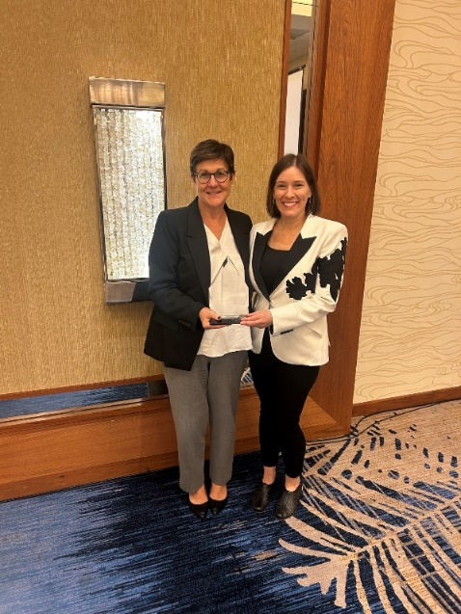
CMC EEEC Award- The Lemelson Foundation
Engineering for One Planet -Pilot Grant Program in Partnership with VentureWell
There were Five pilot grantees participated in the two-year program, receiving seed grants and participating in a supported Community of Practice.
Arizona State University (ASU)
Villanova University
Oregon State University (OSU)
University of Maryland (UMD)
University of Central Florida (UCF)
Grantees used the EOP Framework to develop or modify a total of 61 courses ( 50 were required engineering courses), reaching 5908 students, primarily undergraduate.
The EOP Pilot Grant Program spurred lasting curricular changes at the five institutions, and the lessons learned helped shape the future of the EOP initiative, including the ASEE EOP Mini-Grant program launched in 2022.
Notes:
Jackie

Slide 16
ASEE EDI- Idea Pitch and Summary
Idea | Concept | Team
Project Sharin’- Winning Idea | Sophomore level class designed for career development. Establish industry mentors ( Ratio of 3:1 with students). Industry can “zoom” to be scalable. Current model in progress at St. Louis Univ. | Gregory Triplett ( Dean, St. Louis Univ) Nancy Warter-Perez ( ECST Cal. State LA) Andrew Singer (Incoming Dean SBU) Corey Leclerc (Dean, New Mexico Tech) Bahram Roughani (Assoc. Dean, Loyola MD)
The Fix- Gonzo Table | Internships for faculty in industry and industry in academia to work side-by-side to bridge gap on how we can prepare students for industry; Faculty sabbaticals or summer internships in industry to better understand their needs Modeled after ACE Leadership ProgramThere for faculty meetings, accreditation, grading Exchange program: 1 for 1 | Greg Ball (Dean of George Mason) Michelle Grimm ( Dean of Univ. of Albany) 3 other deans ( did not document) Gaby Arellano Bello (MathWorks)
Dedicated Industry/Univ. Liaison Role | Have a liaison who coordinates activities with multiple partners; Informs stakeholders of trends in industry using data for supply and demand; Have learning coaches | Jeff Alderson (MathWorks) Vanessa Felibery Bautista (Microsoft) Joe Baldwin (Dassault) Eva Mejia (IDEO)
Co-op on Steroids | Project-based learning and 1 year leadership academy; 2 years of co-op with a learning coach | Brian Martenson (Ex. Director, Min Poly) Jim Sherwood (Dean Umass Lowell)
Notes:
PJ can explain and introduce Gregory 5 mins

Slide 17
Industry and Higher Education Collaborations
Gregory Triplett, PhD
- Dean School of Science and Engineering

Slide 18
Industry/Academic Collaborations making a positive difference in our community, state, nation and world.
Career ready graduates
Business growth/operational efficiency
Workforce that can adapt to a continuous learning mindset
Outcomes for Collaborations
A sustainable/scalable industry & academia collaboration
Foster a climate of mentoring
Build strategic regional partnerships
Grow multi-disciplinary areas. Ex: energy, engineering for healthcare, biomedical informatics, cyber security, big data.
Enroll, retain, and support a diverse student body that understands the importance of industry relevant projects
Expose promise/potential of engineering careers
Professional Development
Sophomore year experience
Incorporate into curriculum
Small group mentoring (4:1)
1-hour per session/ 3 per term
Topics include: ethics, hot areas, soft skills, insights
Built-in remote option
Alumni & members of business communities

Slide 19
- MEET YOUR MENTOR SESSION -
Program Objective #1. | Establish a mentoring environment that encourages professional and personal development of mentors and mentees alike.
Program Objective #2. | Give students the chance to develop broader perspectives on their beliefs and aspirations, and improve their capacity to make decisions in both their personal and professional lives.
Program Objective #3. | Help develop in students the leadership, communication, professionalism, critical thinking, and other skills that are crucial for success in the workplace.
Program Objective #4. | Foster genuine connections that will help the engineering community grow and flourish.
For a successful mentoring session, students must:
Prepare and ask relevant questions.
Be respectful of the mentor’s time and experience.
Ask if they can follow up and exchange contact information.
Thank the mentor for their advice with an email.

Slide 20
15 Minute Roundtable Discussion
Is there an opportunity for Project Sharin’ at your university and what would it take to implement?
What are new trends to explore in future industry surveys? How should we best conduct these to help make them actionable?
What other big ideas do you believe CMC should explore in collaboration with Deans and Academia?
What benefits would your Industry partners value to be part of CMC to grow our membership?
Notes:
25 mins

Slide 21
Wrap-up and Next Steps (10 mins)
Notes:
We are now going to vote and get the CMC vote and your vote online for the best ideas. We will bring the top ideas to the CMC team and explore them more during our industry day at the annual meeting.

Slide 22
Join us at the ASEE Annual Conference CMC Industry Day Tuesday June 25th
CMC Keynote- Fireside Chat Jim Hanna, Director, Microsoft and Yash Tadimalla, UN Youth Delegate
4 CMC Sessions
9:15 Strategies for Advancing Diversity, Equity, and Inclusion: Breaking Barriers and Creating Pathways
11:00 When Every Job is a Climate Job: The Role of Engineering Education
1:30 Aligning Industry, Educators, and Policymakers to Develop the Skilled Technical Workforce for Industry 4.0
3:15 AI Effects on Education- The Good, the Bad and the Ugly
Notes:
We are now going to vote and get the CMC vote and your vote online for the best ideas. We will bring the top ideas to the CMC team and explore them more during our industry day at the annual meeting.
When Every Job is a Climate Job: The Role of Engineering Education
Tuesday, June 9:15-10:45
Moderator: Cindy Cooper
Strategies for Advancing Diversity, Equity, and Inclusion: Breaking Barriers and Creating Pathways
11-12:30
Moderator: PJ Boardman
Aligning industry, educators and policymakers to develop the skilled technical workforce for Industry 4.0
1:30-3
Moderator: Maine State Representative Dan Sayre.
AI in Education: A Corporate View for Academia
3:15-4:45
Moderator: Patrick Kane

